Slide 1
DSA210 Project Presentation
Ege Büyükacaroğlu-34135

Slide 2
Motivation
I want to analyse the relations between my Social Media and High Quality Media consumption alongside this I also want to distinguish Holiday and Workdays effect on my media consumption
Instagram
Reddit
Youtube
High Quality Media:
Films
Comic/Manga
Story Driven Games

Slide 3
My Data Set: Through(31 March-20 April)
Phone Instagram Usage
Phone Reddit Usage
Phone Youtube Usage
Tablet Youtube Usage
Tablet Chunky(Comıc Reader) Usage
Steam Playtime
IMDB Ratings
Holiday/Workday

Slide 4

Data Collecting Methodes: Phone/Tablet Usages
All phone and tablet app usage data derives from Screen Time function of apple ecosystem
After getting the usage data I created a comma separated value file (.csv) Including date(DD-MM-YYYY),Relative App Usage,Total that days screentime

Slide 5

Data Collecting Methodes: IMDB Ratings
IMDB Ratings taken from my account’s ratings via IMDB’s export as csv function then i manually editted the csv and removed unnecessairy columns and sorted for data range
It lists runtime in minutes format and dates in YYYY-MM-DD format

Slide 6

Data Collecting Methodes: Steam Playtime
For, getting steam’s playtime I used a third party software called Playnite. This software allows users to manage steam library in a organized manner and presents a large lists of extensions to track steam playtime by day via using users Steam API.
I only logged single player story driven games gathered from Playnite into comma seperated value file ( csv same format as screen time)

Slide 7
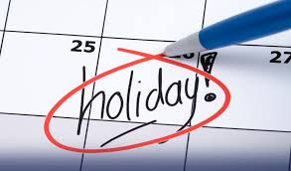
Data Collecting Methodes: Holiday/Workday
I created a comma seperated value file for each day entries
Holiday column 1 for holidays 0 for Workdays
Official Holidays and Saturday Sunday Monday and Wednesday logged as holidays

Slide 8
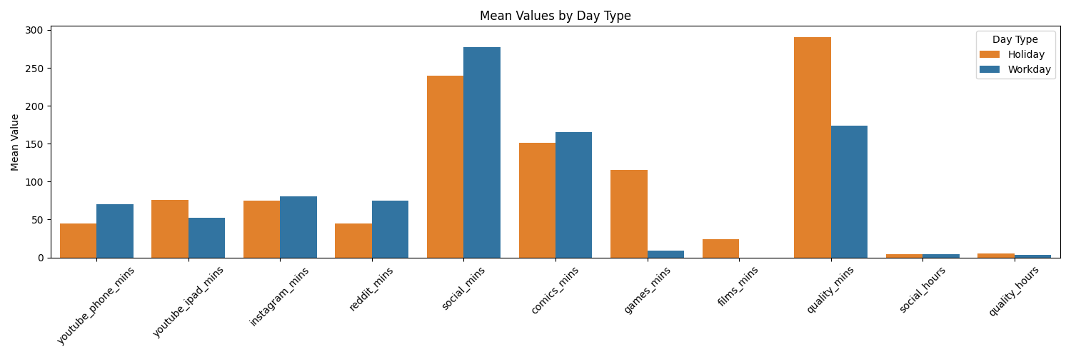
Combined DataFrame :Grouped Bar Chart

Slide 9
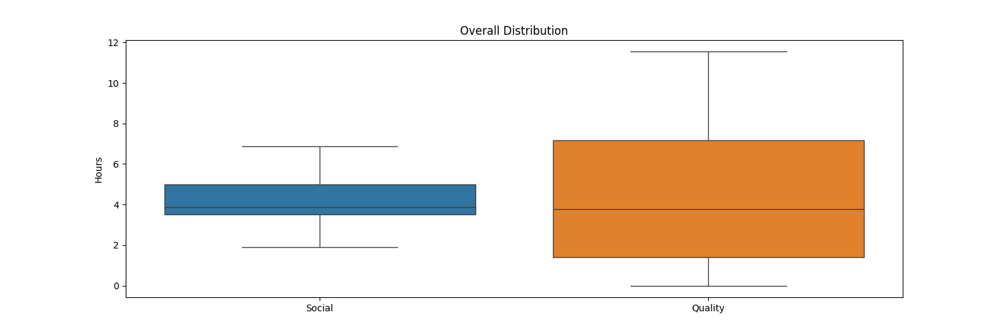
Hypothesis Testing: Hypothesis 1
Total Hours of two types of media consumption
My first hypothesis is for figuring out is there a connection between my social media consumption and quality media consumption
Null Hypothesis (H₀): There is no meaningful connection between my Quality Media Consumption and Social media consumption (X ₀ = X ₐ)
Alternative Hypothesis (Hₐ): There is a meaningful connection between Quality Media consumption and Social media consumption(X ₀ != X ₐ)
Default significance : α =0.05
For this hypothesis test I will use pearson correlation and randomization test

Slide 10
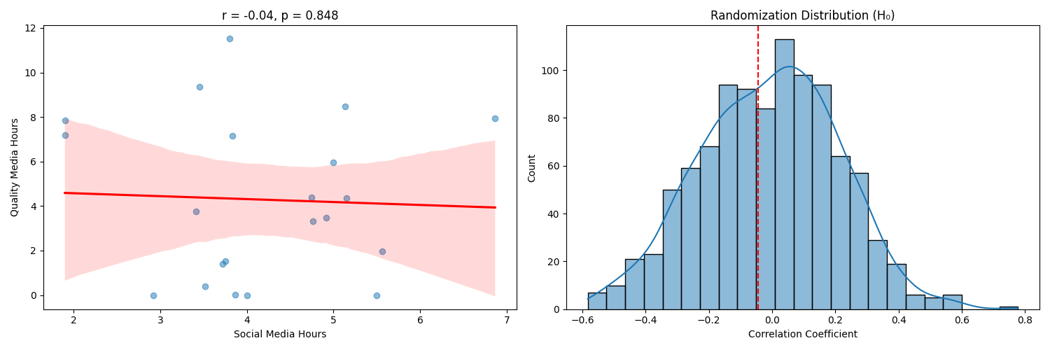
Hypothesis Testing: Hypothesis 1 Results
p-value:0.8479
Conclusion: Fail to reject the null hypothesis there are not enough evidence

Slide 11
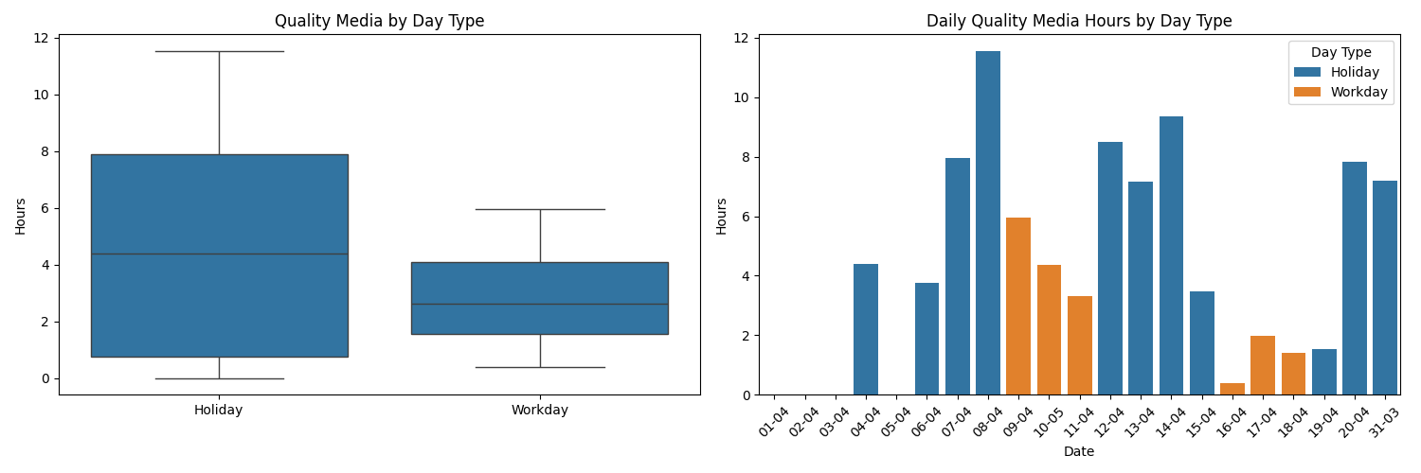
Hypothesis Testing: Hypothesis 2
My second hypothesis for figuring out is there a connection between my Quality Media Consumption and Day Type
Null Hypothesis (H₀): There is no meaningful connection between my Quality Media Consumption and Day Type (X ₀ = X ₐ)
Alternative Hypothesis (Hₐ): There is a meaningful connection between Quality Media consumption and Day Type (X ₀ != X ₐ)
For this I used two sample t-test to measure impact of day type’s on Quality Media

Slide 12
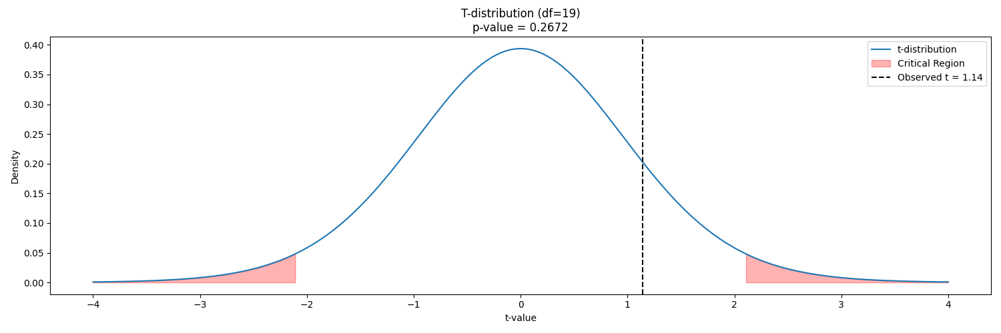
Hypothesis Testing: Hypothesis 2 Results
p-value:0.2672
Conclusion: Even if p-value lower than previous hypothesis test we still fail to reject the null hypothesis there are not enough evidence

Slide 13
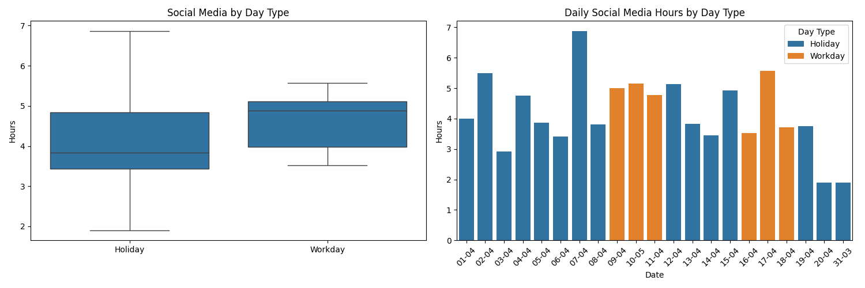
Hypothesis Testing: Hypothesis 3
My third hypothesis for figuring out is there a connection between my Social Media Consumption and Day Type
Null Hypothesis (H₀): There is no meaningful connection between my Social Media Consumption and Day Type (X ₀ = X ₐ)
Alternative Hypothesis (Hₐ): There is a meaningful connection between Social Media consumption and Day Type (X ₀ != X ₐ)
For this I used two sample t-test to measure impact of day type’s on Social Media

Slide 14
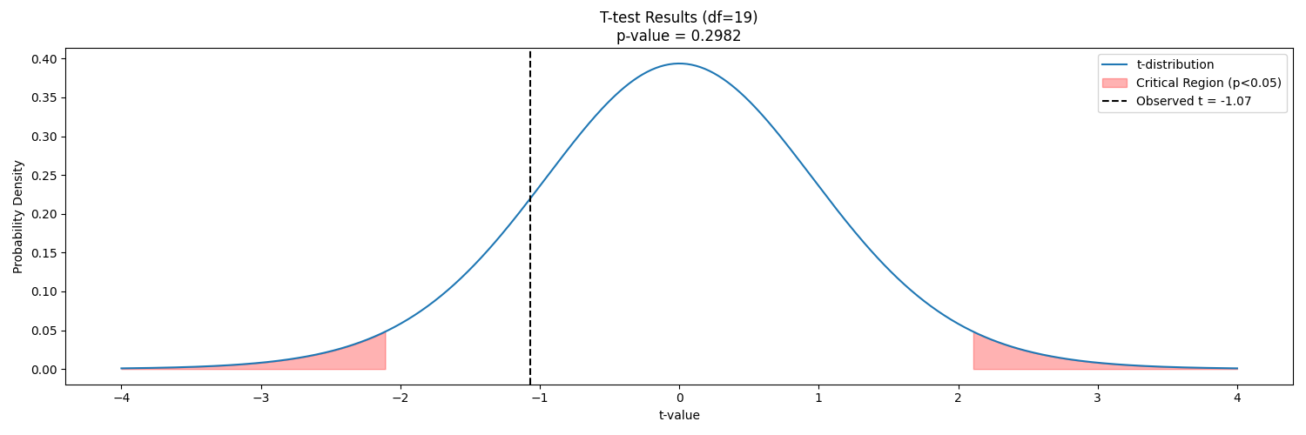
Hypothesis Testing: Hypothesis 3 Results
p-value:0.2982
Conclusion: Fail to reject the null hypothesis there are not enough evidence

Slide 15
Hypothesis Testing: Hypothesis 4
My fourth hypothesis is for figuring out that is if quality media usage differs on usage of different Social Media apps
Null Hypothesis (H₀): Different platforms does not effect quality media usage differently(U1 = U2 = U3 )
Alternative Hypothesis (Hₐ): Different platforms does effect quality media usage differently (Any Differs)
For this hypothesis test I will use ANOVA Test

Slide 16
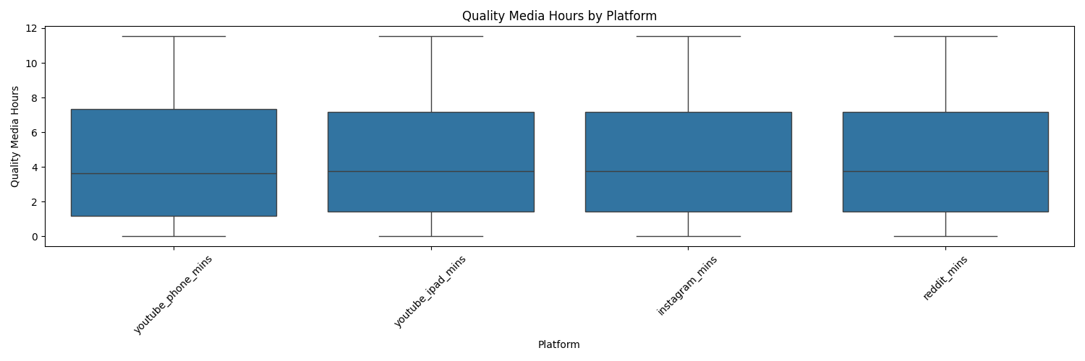
Hypothesis Testing: Hypothesis 4 Results
p-value:0.9989
Conclusion: P-value is incredibly high on this one as we can see on the below graph their overall means incredibly similar so we can safely say that we fail to reject the null hypothesis, there are not enough evidence

Slide 17
Hypothesis Testing: Overall Conclusion Summery
Hypo 1: In my research and testing I couldn’t find any meaningful relation between my social media usage and quality media consumption
Hypo 2/3:In my research Holiday and Workday media consumption somewhat differs from eachother but not it is not enough for we to reject null hypothesis
Hypo 4: There is little to no diffrence between impacts of different Social Media apps

Slide 18
ML Methods application
For machine learning I applied three methods to my dataset and selected best methods for Quality and Social time predictions depending RMSE value and visualized predictions and actuall values

Slide 19
ML: Features
For numerical features which consists : ['youtube_phone_mins', 'instagram_mins', 'reddit_mins', 'comics_mins', 'games_mins’]
Standart scaling used: scaler = StandardScaler()
df[num_features] = scaler.fit_transform(df[num_features])
And for classification I have used 0 and 1 as encoding because I have a binary classification: df['day_type_encoded'] = df['day_type'].map({'Workday': 0, 'Holiday': 1})

Slide 20
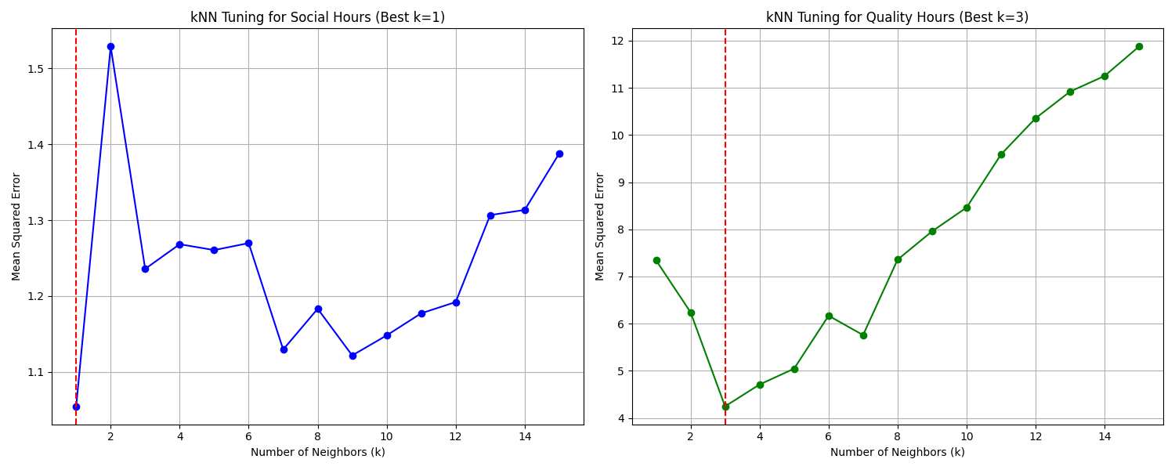
ML: Method KNN
For KNN aplication I have conducted a Cross-Validation test for tuning it’s k parameter.
My test results showed that best k variable for Social = 1 and for Quality = 3

Slide 21
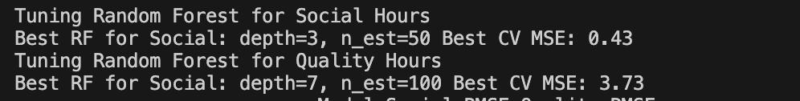
ML: Method Random Forest
I also conducted cross validation tests to figure out best parameter values for Random Forest’s: Depth and N estimation
Results:

Slide 22
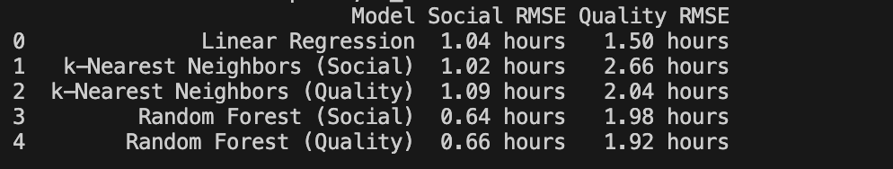
ML: Method interperation
In my testing I found out that for Quality the best ML method is Linear Regression with 1.50 RMSE and for Social best method is Random Forest Method with RMSE 0.64
(Social) : With Social Tuning
(Quality) : With Quality Tuning

Slide 23
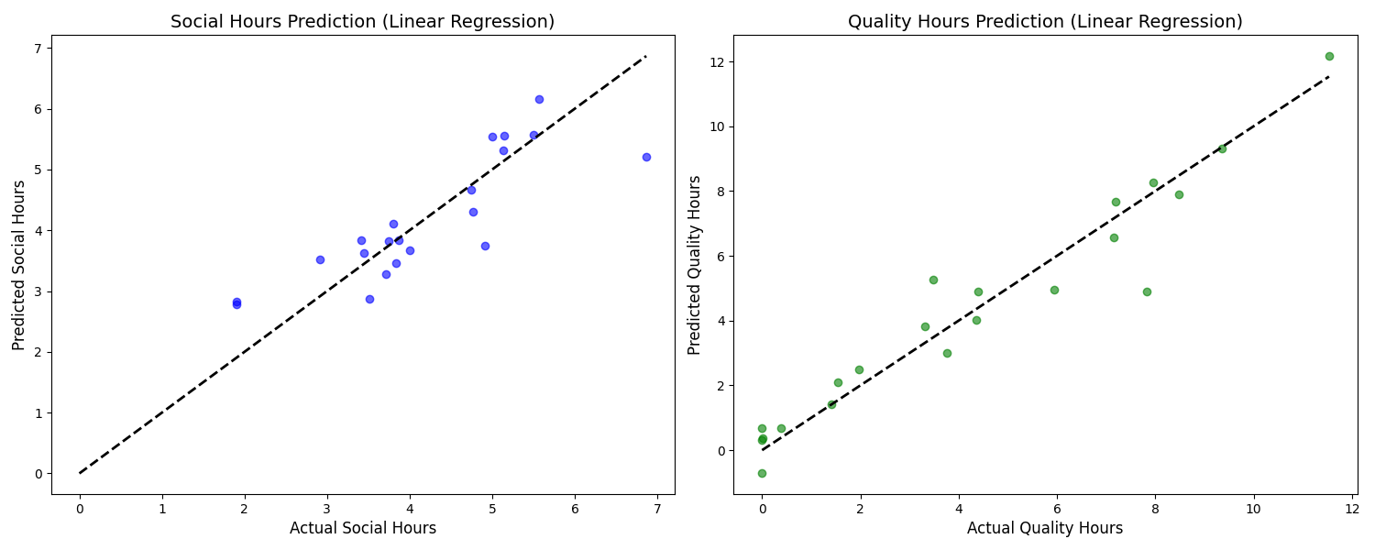
ML: Linear Regression Visualization

Slide 24
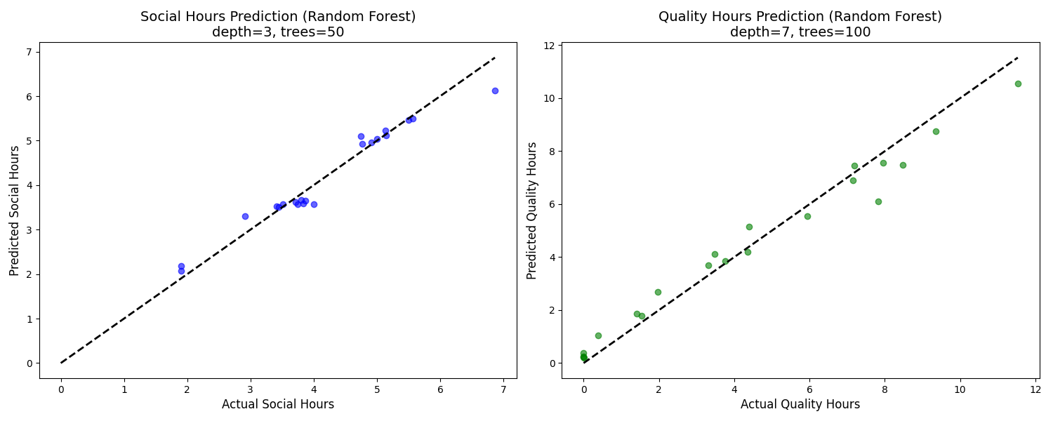
ML: Random Forest

Slide 25
Limitations: What could done better?
Steam Playtime tracking was a very difficult process. Normally steam only allows for two weeks total playtime. For, getting game specific and daily data third party apps needs to be used as explained (Playnite), Which sometimes does not work properly and resulted in some data being lost. I could use a better technique to track
Due to data covers just 3 week period results may not be a good representetive for long-term habits

Slide 26
Future Work
A year-long data collective period with more accurate methods of data collection
Extended feature pool with additional hobbies
Additional can be added classification In day time cycles such as Morning, Noon, Night

